Slide 1

Baltimore County Department of Public Works and Transportation
Katherine Klausmeier, County Executive
Baltimore Water Governance Workgroup
Overview of Baltimore County
Water, Wastewater, and Stormwater Management
Notes:
Good Evening. I'm Michael Swygert, the Chief of Metropolitan Finance and Petitions in Baltimore County DPWT. Tonight I have a brief presentation on Sewer Service charges and how they effect Stevenson Village.

Slide 2
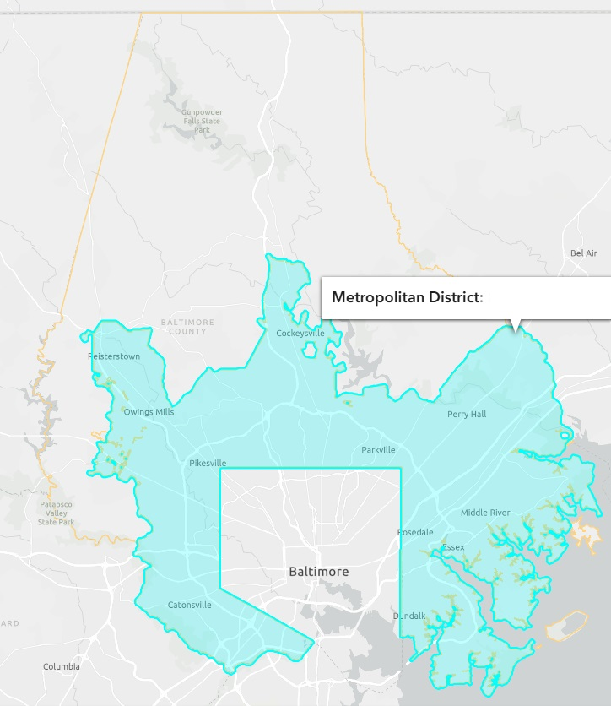
County Utility Service Boundary
The Metropolitan District
  Established in 1924
  Geographic boundary within which a property may be eligible to receive public water and sewer service
  Changes to the boundary must be approved by the City and County
  Approximately 220,000 properties served over 209 square miles

Slide 3
Baltimore County Division of Duties
DPWT Bureau of Utilities
  Sewer operations and maintenance
DPWT Office of Metropolitan Finance and Petitions
  Billing and customer service for utility-related charges
DPWT Bureau of Engineering and Construction
  Design and construction of new, replacement & rehab projects for water, sewer and storm drains
Office of Budget and Finance
  Billing of utility charges and rate setting
Department of Environment and Sustainability
  Includes stormwater planning and management
There is no City cost share for the work performed by these County divsions.

Slide 4
Utility Assets - Water
Baltimore City owns and is responsible for the water infrastructure in Baltimore County. Baltimore County has no operational control over water assets within Baltimore County.
Baltimore County is responsible for Capital water main replacement/rehabilitation and system extension projects

Slide 5
Utility Assets - Wastewater
Baltimore County owns and operates the wastewater system within the County. The only exception is the Back River wastewater treatment plant (BRWWTP), the two outfall lines from the City to BRWWTP and the effluent from BRWWTP that runs south through the Trade Point Altantic site. The County has no operational control over these City assets.
The County sanitary sewer collection, pumping, transmission and treatment system consists of:
  ~3,000 miles of pipeline (gravity and pressure)
  120 pumping stations
  ~60,000 manholes
  ~2,600 grinder pumps
  one small community sewage treatment plant
Baltimore County generates approximately 1,000,000,000 gallons of sewage annually
The average age of the system is approximately 55 years old.

Slide 6
Cost Sharing – Water System
Costs are reconciled annually based on actual costs incurred by Baltimore City to operate and maintain the water utility. The County pays for the following:
  all costs related to the City billing of County customers
  all water used
  the operation and maintenance of the system based on the proportion of water consumed
  depreciation
  capital cost share
The County funds the capital costs for joint‑use water facilities as outlined in the concurrence letters between the City and the County. Costs are based on volumetric ratios.

Slide 7
Cost Sharing – Wastewater System
Joint Costs paid by County to City quarterly and reconciled at the end of the year
The County pays for the following:
  County share of operations for joint use facilities, including wastewater treatment plants.
The County funds the capital costs for joint‑use sewer facilities as outlined in the concurrence letters between the City and the County. Costs are based on volumetric ratios.

Slide 8
Key Differences in Sewer Rate Setting and Operations
Baltimore City and Baltimore County each set their own sewer retail rates.
County water rates are approved by the Board of Estimates.
County sewer rates are established by executive order under Article 20 of the Baltimore County Code.
The County uses a 3rd party Cost-of-Service (CoS) study to ensure revenue matches expenses within industry standards. The latest study was finished in 2023, and a CoS should be carried out every three to five years.

Slide 9
County Stormwater Program
DPWT – Storm Drainage & Floodplain Management
Storm drain repair & enhancements — General Fund - $4M over 2 years; plus grants including ARPA and federal grants
Green infrastructure (rain gardens, infiltration systems) — Included in storm drain enhancement funding; part of $4M
Floodplain studies, acquisitions, floodproofing — General Fund; $1.85M available over 2 years
DPWT – Utilities
Inlet maintenance (one-time supplement) — Operating budget; $1.5M
Additional inlet funding (biennial) — Operating budget; $1M every 2 years
Small stormwater system repairs — Operating budget; $500k

Slide 10
County Stormwater Program (continued)
DPWT – Highways
Runoff management (swales, culverts)
DEPS (Environmental Protection & Sustainability)
Stormwater discharge quality management
Stream restoration and watershed protection (protecting sewers & raw water reservoirs) — Metropolitan District Fund; $10M per year

Slide 11
County Stormwater Program (continued)
DEPS (Environmental Protection & Sustainability) (continued)
In 2014, the County implemented a Stormwater Remediation Fee, following a 2013 State of Maryland mandate requiring local governments to fund Chesapeake Bay pollution‑reduction efforts.
The fee was based on the amount of impervious surface area on a property (e.g., roofs, driveways) and initially charged to single‑family homes.
In 2015, the County Council voted unanimously to phase out and eliminate the fee.
After the phase‑out, the County still needed to meet stormwater management and MS‑4 permit requirements, so it shifted to alternative funding sources within the County CIP Budget under the Waterways Improvement Fund:
    $2 million annually in PAYGO funding
    $20 million in each bonding referendum to aid in addressing stormwater and waterway improvements

